Slide 1
Housing Recovery on the Gulf Coast
Paul Joice, MPP
Social Science Analyst
Program Evaluation Division
Office of Policy Development and Research

Slide 2
CDBG Disaster Recovery Assistance
Community Development Block Grant (CDBG):
a flexible formula-based block grant program administered by HUD since 1974.
Grantees include1,209 states and local governments.
Distributed by formula, not a competitive grant. Grantees are required to submit an Action Plan each year to HUD, to ensure that the planned activities are eligible.
Eligible activities include community development, housing rehabilitation, and production of affordable housing.

Slide 3
CDBG Disaster Recovery Assistance
After Hurricanes Katrina and Rita, supplemental appropriations of $19.7 billion went to Alabama, Florida, Louisiana, Mississippi, and Texas.
December 30, 2005; P.L. 109-148; $11.5 billion
June 15, 2006; P.L. 109-234; $5.2 billion
November 13, 2007; P.L. 110-116; $3 billion just for Louisiana

Slide 4
Tracking Recovery in LA, MS and TX
Two main components:
Windshield observations (assessments of exterior property condition, as viewed from the street) . Results to be published in Fall 2010.
A telephone survey of the individual who owned a property in 2005. Results to be published in Summer 2011.

Slide 5
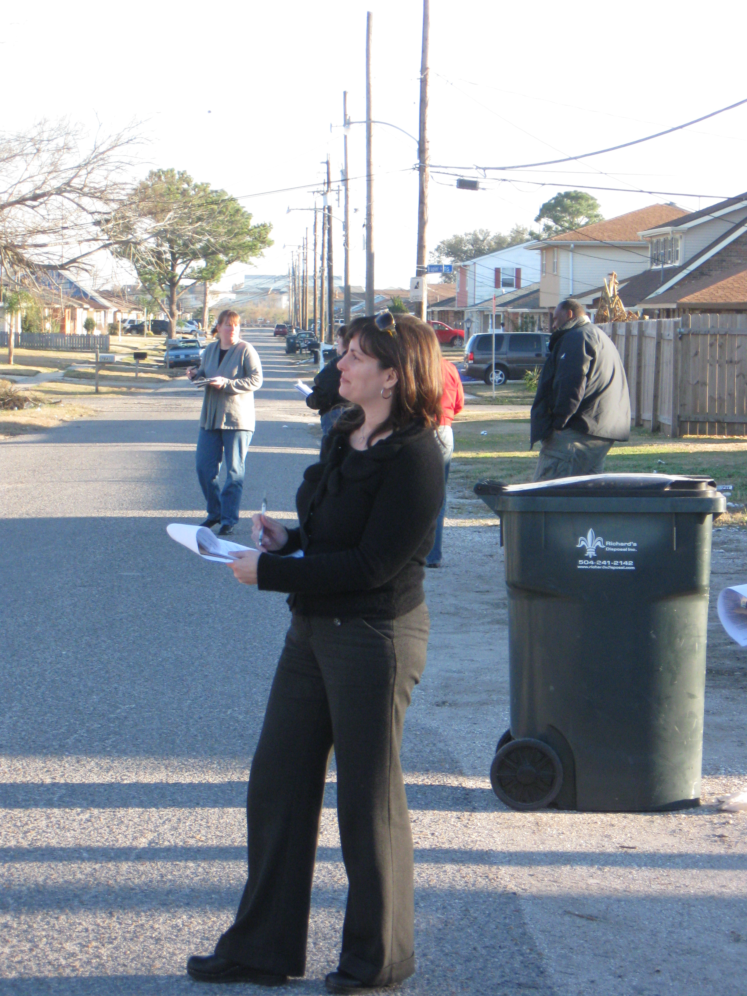
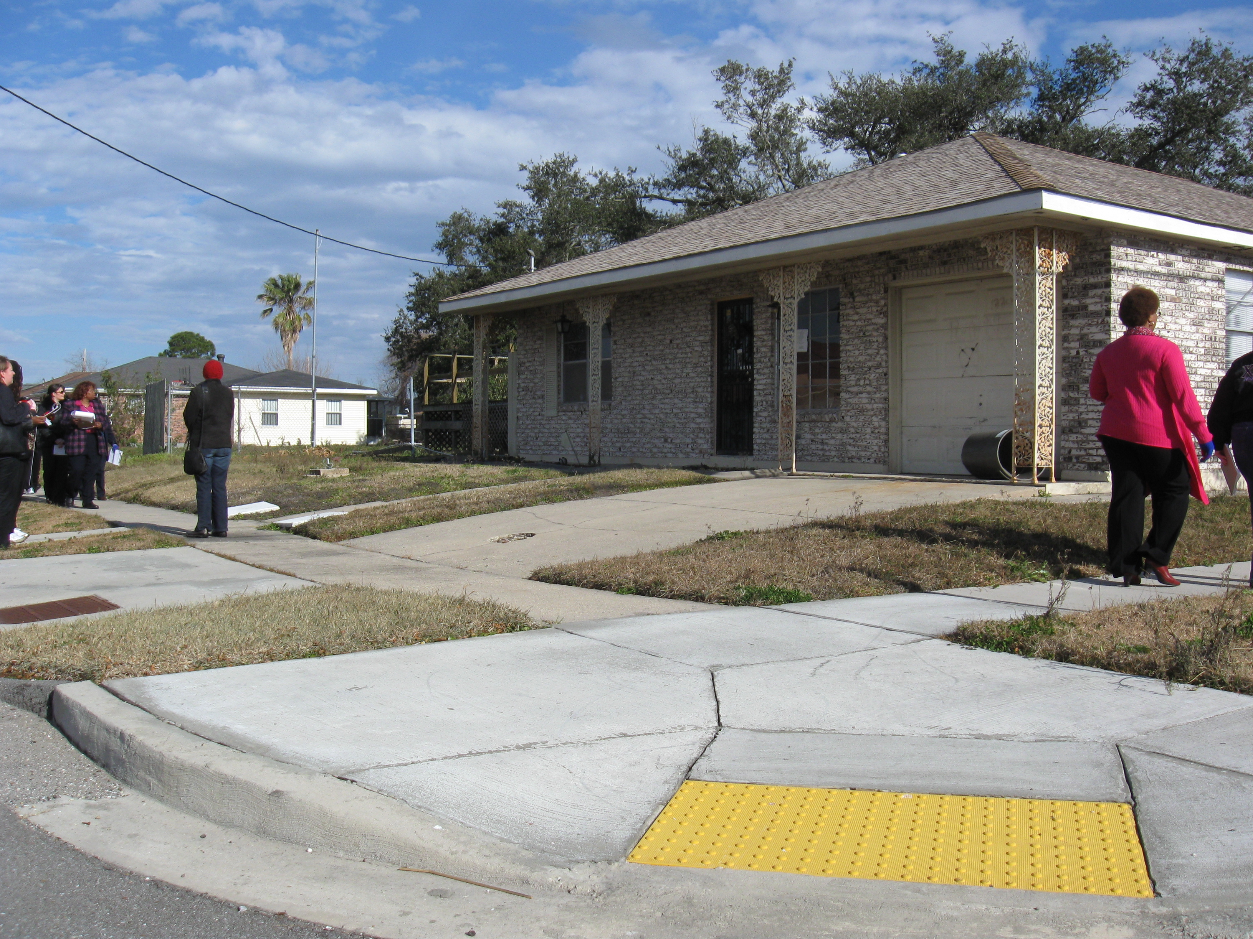
Windshield Observations

Slide 6
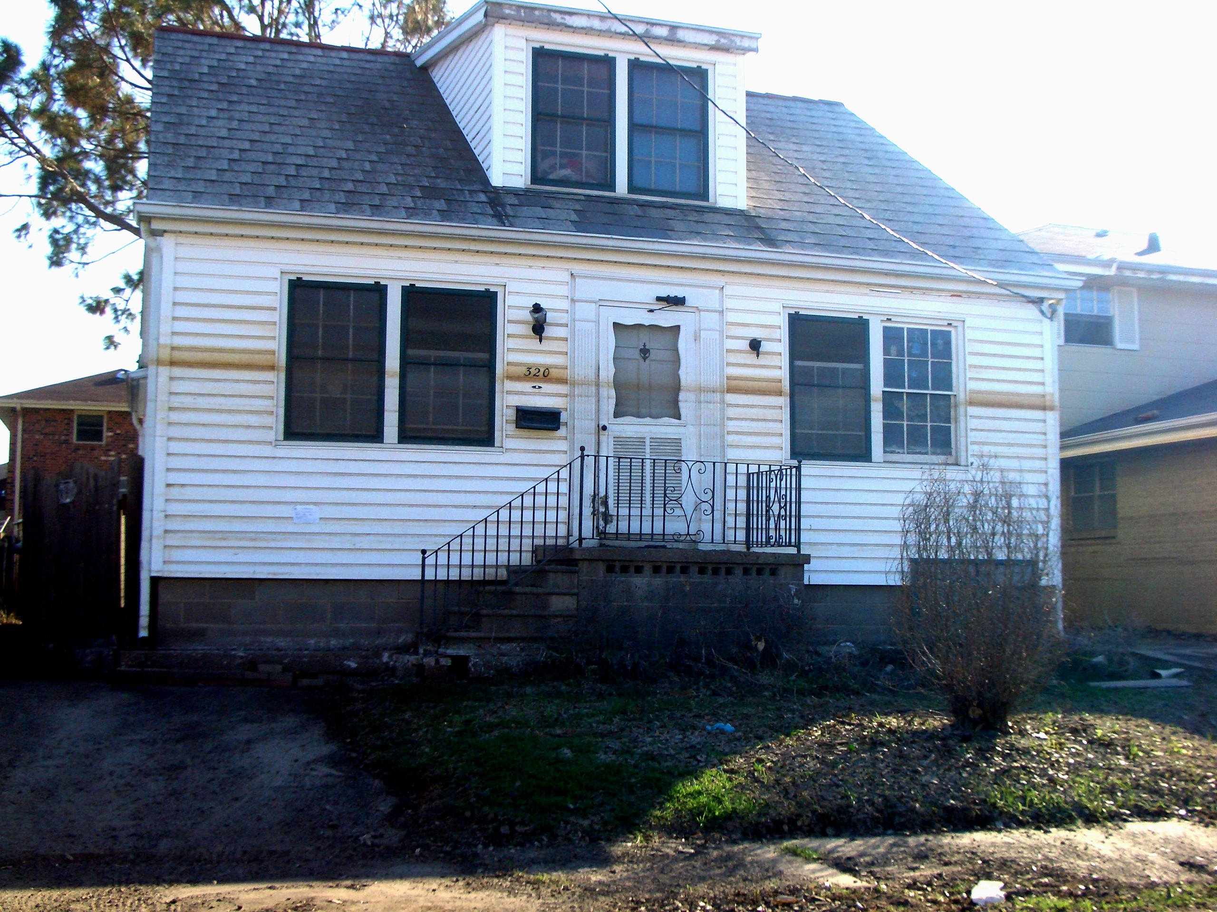

Slide 7
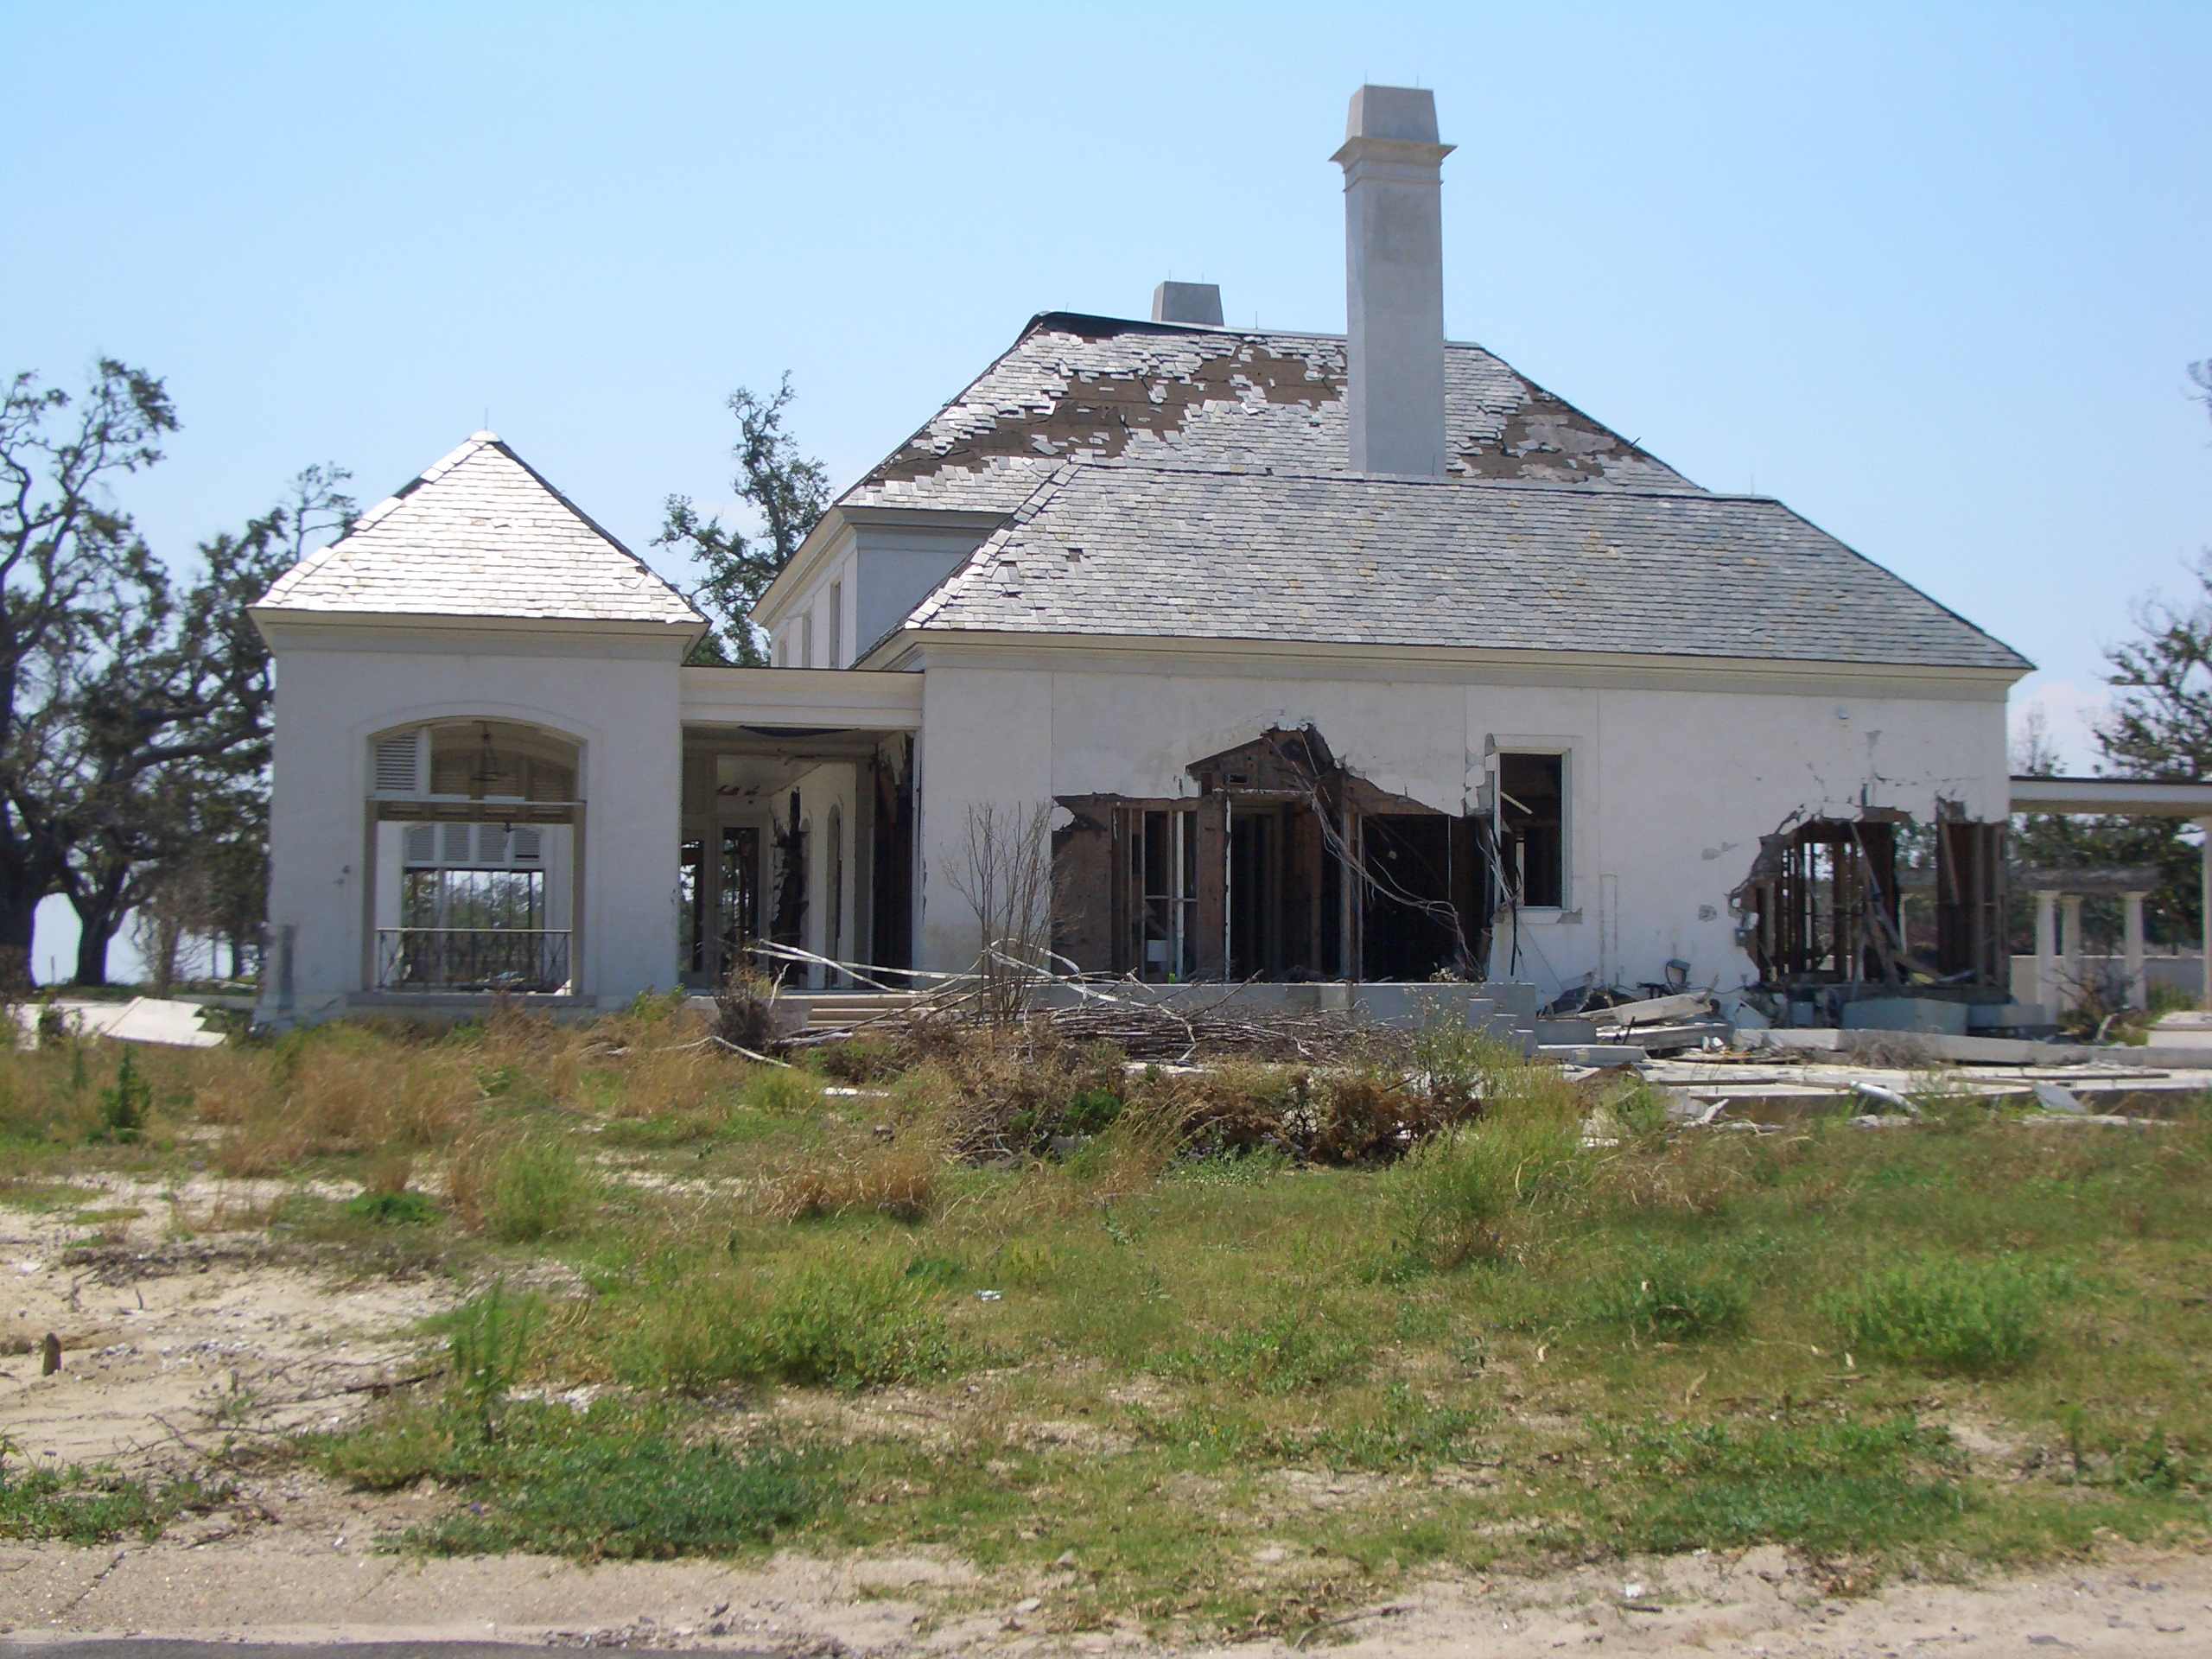

Slide 8
Tracking Recovery in LA, MS and TX
Study focuses on hurricane-damaged properties on “significantly affected blocks” (SABs) in Louisiana, Mississippi, and Texas
Data on initial damage from FEMA damage
assessments conducted August 2005 to February
2006.
- 875,543 total housing units suffered some type of damage. That included one third of all occupied housing units in Louisiana and one fifth of all occupied housing units in Mississippi.
- 90% of housing with major or severe damage was on a significantly affected block.

Slide 9
Sampled SABs, Louisiana
Sampled blocks in Louisiana spanned the following parishes: Calcasieu and Cameron, Jefferson, Orleans, St. Bernard, and St. Tammany.
Within Orleans parish, the sample was further stratified to provide estimates for the following neighborhoods (“Planning Districts”): MidCity, Lakeview, Gentilly, Lower Ninth Ward, New Orleans East, and Uptown.

Slide 10
Sampled SABs, Mississippi
Sampled blocks in Mississippi spanned the following counties: Hancock, Harrison, and Jackson.
The sample was further stratified to provide estimates for the following cities: Waveland and Bay St. Louis, Biloxi, Gulfport, Pass Christian and Long Beach City, and Pascagoula.

Slide 11
Key Findings – Overall Recovery
Summary of conditions in all 3 states, as of early 2010:
74.6% of hurricane-affected properties on SABs had no substantial repair needs.
10.8% of hurricane-affected properties on SABs no longer contained a permanent residential structure.
The remaining 14.6% contained a residential structure with substantial repair needs.

Slide 12
Conditions of Hurricane-Affected Properties, Early 2010 – Louisiana
Jurisdiction | Total # of affected properties | % vacant lots | % with repair needs
Jefferson Parish | 46,930 | 1.2 | 3.1
Orleans Parish | 94,415 | 6.7 | 27.7
(Lower 9th Ward) | 6,621 | 29.8 | 22.6
(MidCity) | 15,291 | 3.2 | 54.3
(ByWater) | 11,278 | 8.5 | 39.9
(Lakeview) | 7,258 | 13.4 | 10.8
St. Bernard Parish | 24,025 | 32.5 | 5.9
St. Tammany Parish | 25,610 | 10.3 | 6.0
Louisiana total | 217,401 | 9.4 | 16.1

Slide 13
Conditions of Hurricane-Affected Properties, Early 2010 – Mississippi
Jurisdiction | Total # of affected properties | % vacant lots | % with repair needs
Hancock County | 7,789 | 44.7 | 6.3
Harrison County | 31,247 | 13.3 | 7.3
(Biloxi) | 6,323 | 32.4 | 12.4
(Gulfport) | 11,701 | 3.8 | 3.1
(Pass Christian and Long Beach City) | 8,506 | 19.5 | 13.4
Jackson County | 32,571 | 15.4 | 6.5
(Pascagoula) | 9,363 | 9.4 | 0.0
Mississippi total | 76,499 | 16.9 | 7.5

Slide 14
Key Findings – Factors That Influence Rebuilding
Effect of neighborhood conditions (Census 2000) on likelihood of a property being rebuilt:
Initial Damage
Neighborhood Home Values
Neighborhood Minority Concentration
Socio-economic Indicator (education or income)

Slide 15
Next Steps
Publish interim report.
Property owner survey: better information about
financial resources and current condition. Context
about challenges of rebuilding.
Continued cleaning and analysis of administrative
data.
Analysis of impact of CDBG on rebuilding.
Final report: expected around May 2011.

